Slide 1

Linear Regression Project on Housing Prices

Slide 2
Team Members
Aashay Dwivedi E20CSE172
Jatin Tayal E20CSE152
Anshul Lamba E20CSE438

Slide 3

Introduction

Slide 4
Our project uses Linear regression to predict housing prices and displays relationship between different factors that affect prices in the housing prices as given in the dataset.
We also compare different such machine learning algorithms that predict the price, based on Coefficient of Determination.

Slide 5
Objectives
To establish relationships between different factors that influence price
To predict price using Linear Aggression
Compare different price predicting algorithms

Slide 6
Python Libraries used
Numpy
Pandas
Sklearn
Seaborn
Matplotlib

Slide 7

Dataset
The dataset contains information from California census of 1990
It has 10 columns and 20,640 rows
Link: https://www.kaggle.com/camnugent/california-housing-prices

Slide 8

Some Inferences

Slide 9
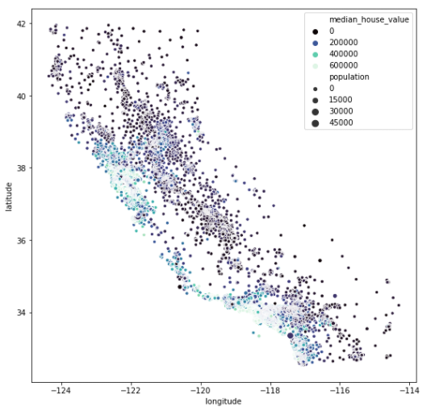
Price with respect to Location
Prices increase as you move towards West
Prices increase as move to the North

Slide 10
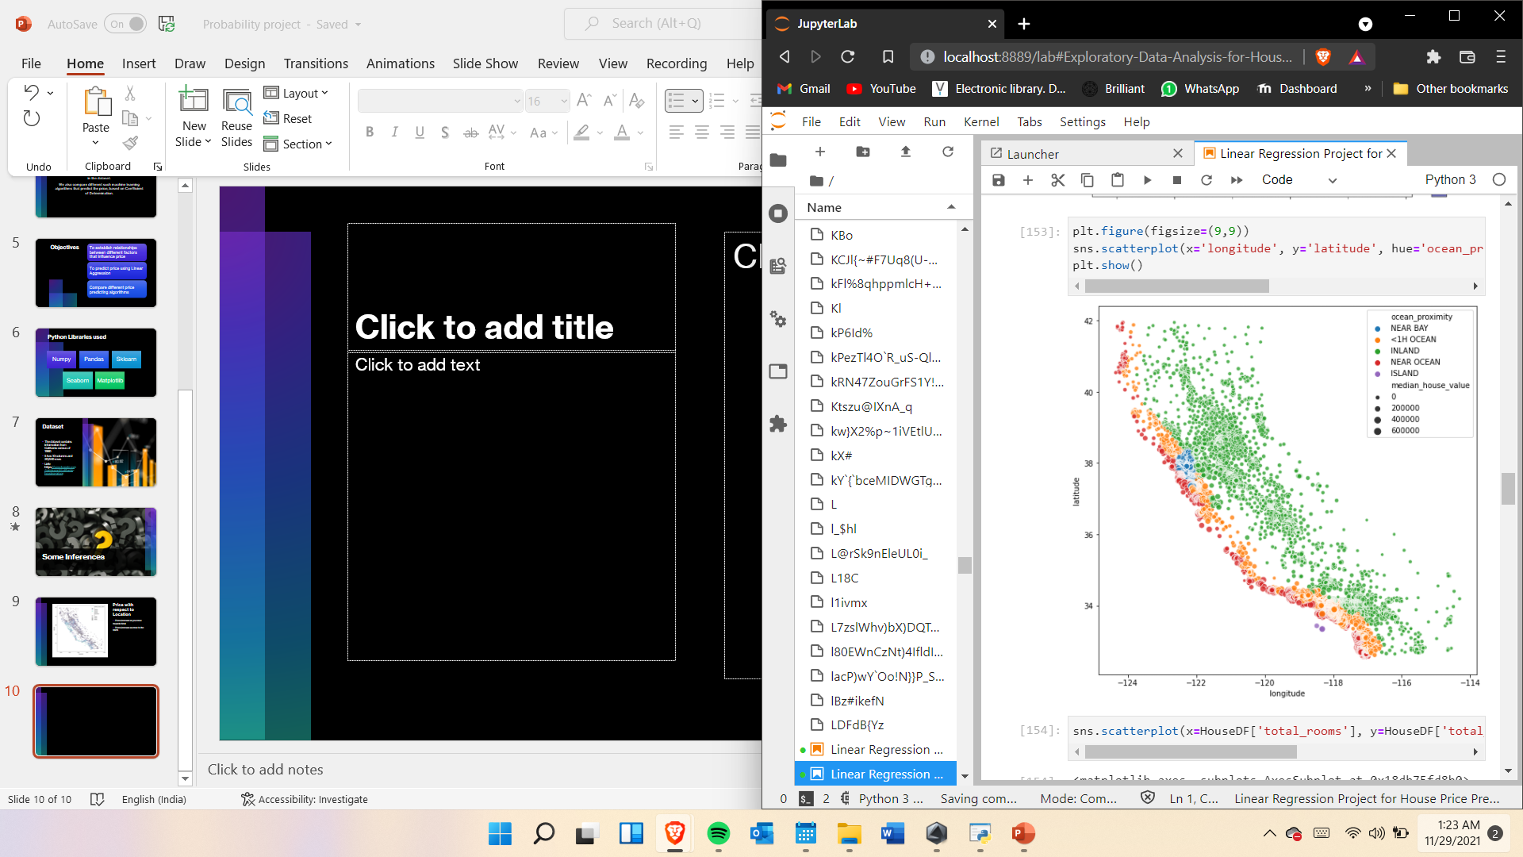
Prices and Location
The most expensive properties are near the ocean
Cheaper options are available inland
Most expensive are island properties

Slide 11
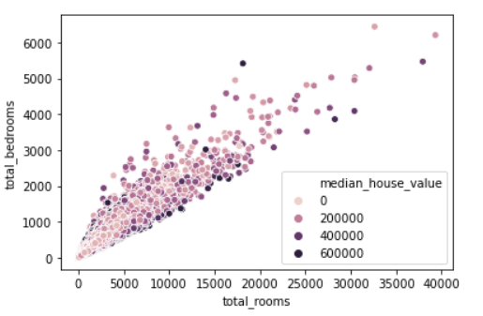
Rooms and Price
Number of rooms does not have much of an impact on price
However, ratio of bedrooms to total rooms does seem to have some effect on the pice

Slide 12

Outcomes of Regression Analysis

Slide 13
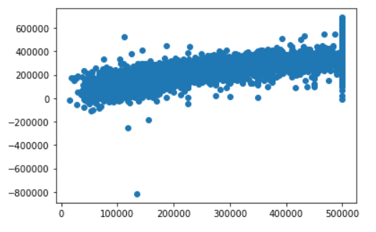
Graphical Representation
Intercept = -3673368.18166

Slide 14
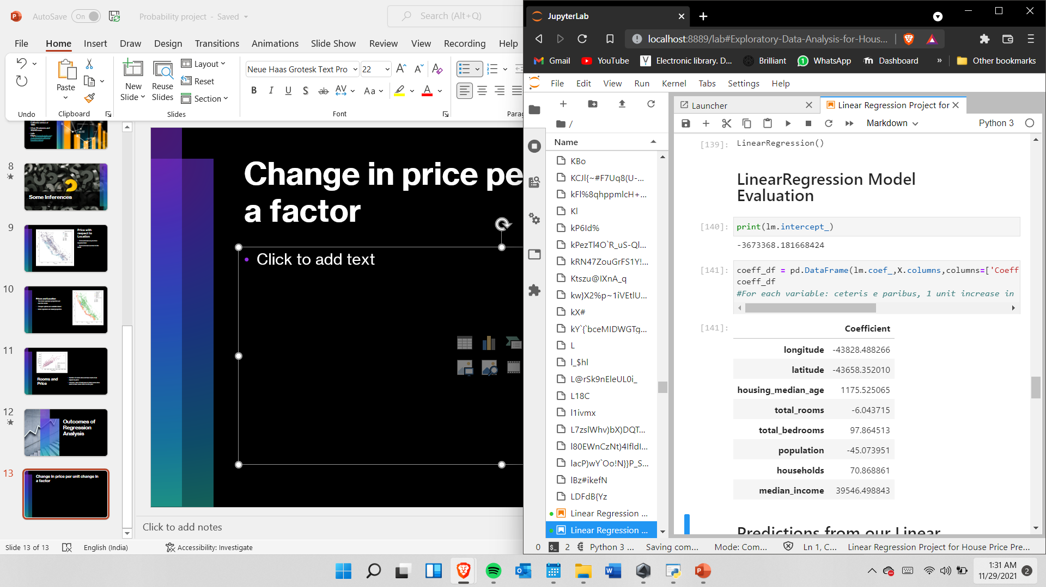
Price Relationship
This is how price changes per every unit change in each of the factors(all thing kept equal).

Slide 15

Machine learning Algorithms for price prediction ranked

Slide 16
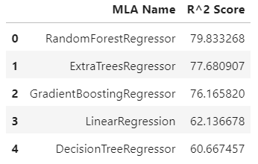
Based on Coefficient of Determination

Slide 17
References
Codecademy.com
Geeksforgeeks.com
Kaggle.com
Youtube.com

Slide 18

Thanks

